Slide 1
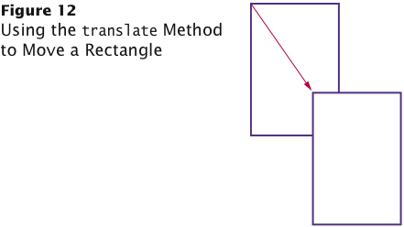

Accessor and Mutator Methods
Accessor method: does not change the internal data of the object on which it is invoked.
Returns information about the object
Example: length method of the String class
Example: double width = box.getWidth();
Mutator method: changes the data of the object
box.translate(15, 25);
The top-left corner is now at (20, 35).

Slide 2

Calling methods that return a value
String greeting = “Hello, World!”;
int numberOfCharacters = greeting.length();
greeting.length();
int halfOfString = greeting.length()/2;
System.out.println(“Length of String: ” + greeting.length());

Slide 3
public class StringPlay
{
public static void main (String[] args){
String myName = new String("Sharon Small");
System.out.println(“Print uppercase: “ + myName.toUpperCase());
System.out.println(“Print original” + myName);
}
}

Slide 4
Self Check 2.25
What does this sequence of statements print?
Rectangle box = new Rectangle(5, 10, 20, 30);
System.out.println("Before: " + box.getX());
box.translate(25, 40);
System.out.println("After: " + box.getX());
Answer: Before: 5 After: 30

Slide 5
Self Check 2.26
What does this sequence of statements print?
Rectangle box = new Rectangle(5, 10, 20, 30);
System.out.println("Before: " + box.getWidth());
box.translate(25, 40);
System.out.println("After: " + box.getWidth());
Answer: Before: 20 After: 20 Moving the rectangle does not affect its width or height. You can change the width and height with the setSize method.

Slide 6
Self Check 2.28
Is the toUpperCase method of the String class an accessor or a mutator?
Answer: An accessor — it doesn't modify the original String but returns a new String with uppercase letters.

Slide 7
Self Check 2.29
Rectangle box = new Rectangle(5, 10, 20, 30);
Which call to translate is needed to move the box rectangle so that its top-left corner is the origin (0, 0)?
Answer: box.translate(-5, -10)

Slide 8
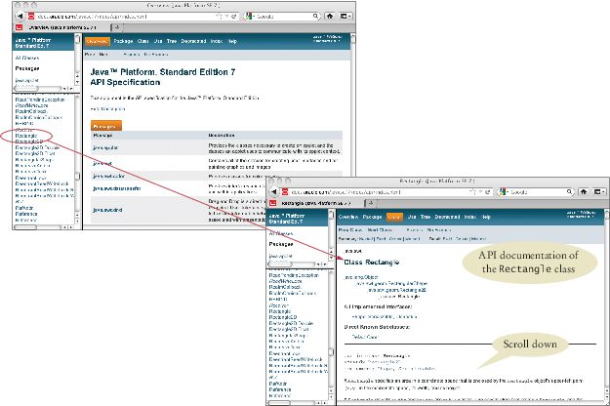
Browsing the API Documentation
Figure 13 The API Documentation of the Standard Java Library
Locate Rectangle link in the left pane
Click on the link
The right pane shows all the features of the Rectangle class

Slide 9
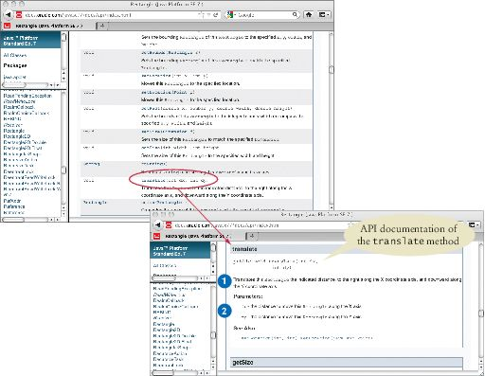
Browsing the API Documentation – Method Summary
Figure 14 The Method Summary for the Rectangle Class
The API documentation for each class has
A section that describes the purpose of the class
Summary tables for the constructors and methods
Clicking on a method's link leads to a detailed description of the method

Slide 10
Packages
Java classes are grouped into packages.
The Rectangle class belongs to the package java.awt.
To use the Rectangle class you must import the package:
import java.awt.Rectangle;
Put the line at the top of your program.
You don't need to import classes in the java.lang package such as String and System.

Slide 11
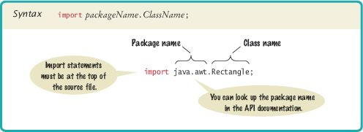
Syntax 2.4 Importing a Class from a Package

Slide 12
Self Check 2.30
Look at the API documentation of the String class. Which method would you use to obtain the string "hello, world!" from the string "Hello, World!"?
Answer: toLowerCase

Slide 13
Self Check 2.31
In the API documentation of the String class, look at the description of the trim method. What is the result of applying trim to the string " Hello, Space ! "? (Note the spaces in the string.)
Answer: "Hello, Space !" – only the leading and trailing spaces are trimmed.

Slide 14
Self Check 2.32
Look into the API documentation of the Rectangle class. What is the difference between the methods
void translate(int x, int y) and
void setLocation(int x, int y)?
Answer: The arguments of the translate method tell how far to move the rectangle in the x- and y-directions. The arguments of the setLocation method indicate the new x- and y-values for the top-left corner. For example,
box.translate(1, 1)
moves the box one pixel down and to the right.
box.setLocation( 1, 1)
moves box to the top-left corner of the screen.

Slide 15
Self Check 2.33
The Random class is declared in the java.util package. What do you need to do in order to use that class in your program?
Answer: Add the statement
import java.util.Random;
at the top of your program.

